Slide 1







DBMS
Lab-5

Slide 2
Things we will complete today
Query on Multiple relation
Aggrigate functions

Slide 3
Aggregate Functions

Slide 4
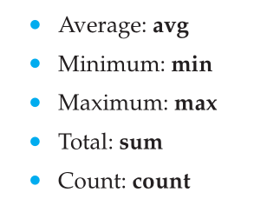
Aggregate functions
Aggregate functions are functions that take a collection (a set or multiset) of values as input and return a single value.
SQL offers five built-in aggregate functions:
The input to sum and avg must be a collection of numbers, but the other operators can operate on collections of nonnumeric data types, such as strings, as well

Slide 5
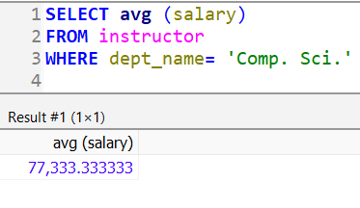
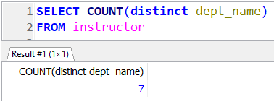
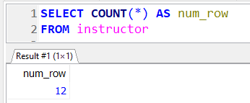
Aggregate functions
Find the average salary of instructors in the Computer Science department
Find the number of departments in instructor relation
Find the number of tuples in the instructor relation

Slide 6
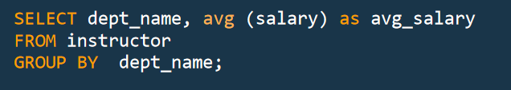
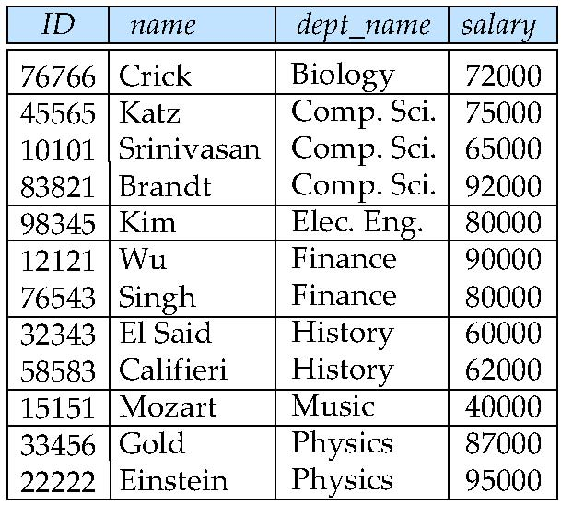
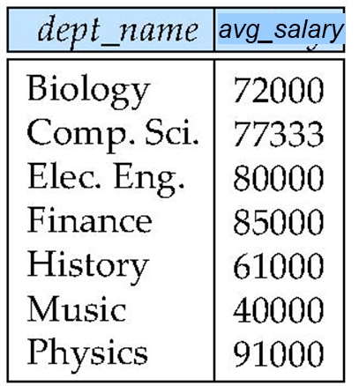
Aggregate functions - Group By
The GROUP BY statement groups rows that have the same values into summary rows like “Find the average salary of instructors in each department”

Slide 7
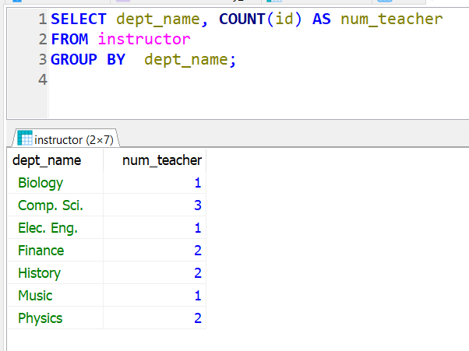
Aggregate functions - Group By
“Find the number of of instructors in each department”

Slide 8
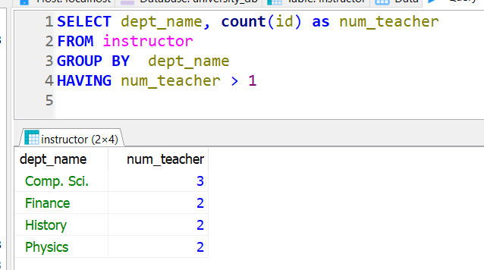
Aggregate Functions – Having Clause
“Find the number of of instructors in each department which have more than one instructors”

Slide 9
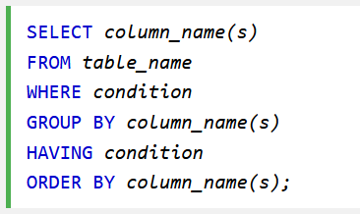
Aggregate Functions – Having Clause
The HAVING clause was added to SQL because the WHERE keyword could not be used with aggregate functions.
Note: predicates in the having clause are applied after the formation of groups whereas predicates in the where clause are applied before forming groups

Slide 10
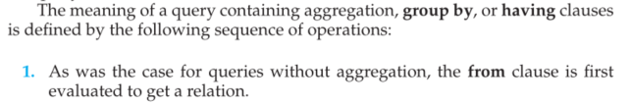
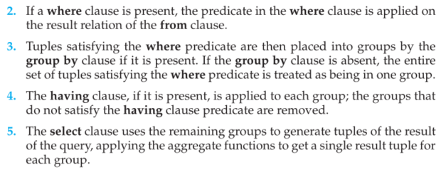
Aggregate Functions – Having Clause
Page 88

Slide 11
Null Values and Aggregates
Total all salaries
select sum (salary ) from instructor
Above statement ignores null amounts
Result is null if there is no non-null amount
All aggregate operations except count(*) ignore tuples with null values on the aggregated attributes
What if collection has only null values?
count returns 0
all other aggregates return null

Slide 12
Query on Multiple relation

Slide 13
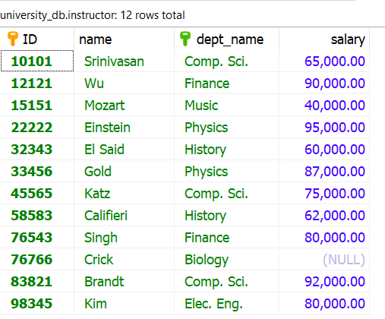
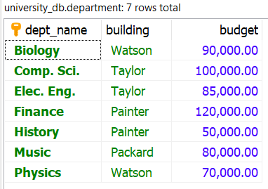
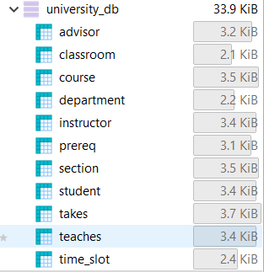
Cartesian Product
Show me a list containing all teachers name, their respective department and the building the department is situated.

Slide 14
Cartesian Product

Slide 15
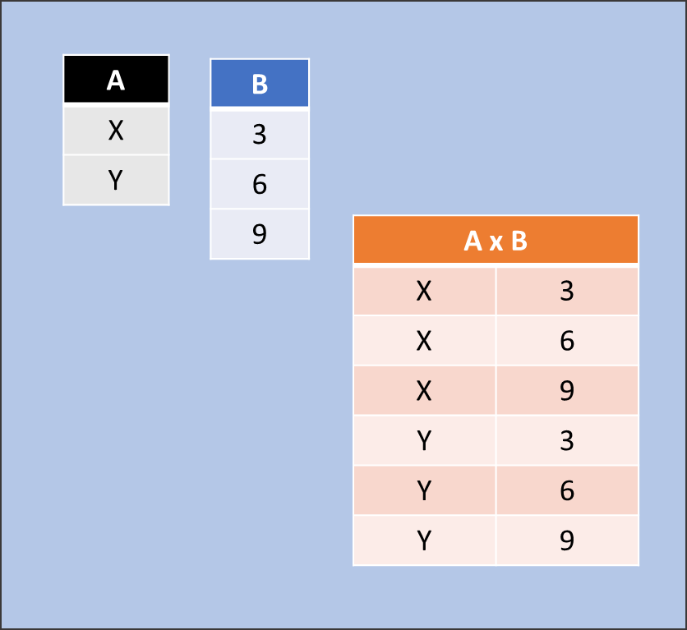
Cartesian Product
The Cartesian product of two sets A and B, denoted by A × B, is defined as the set consisting of all ordered pairs (a, b) for which
a ∊ A and b ∊ B.
For example, if
A = {x, y} and B = {3, 6, 9}, then
A × B = {(x, 3), (x, 6), (x, 9), (y, 3), (y, 6), (y, 9)}

Slide 16
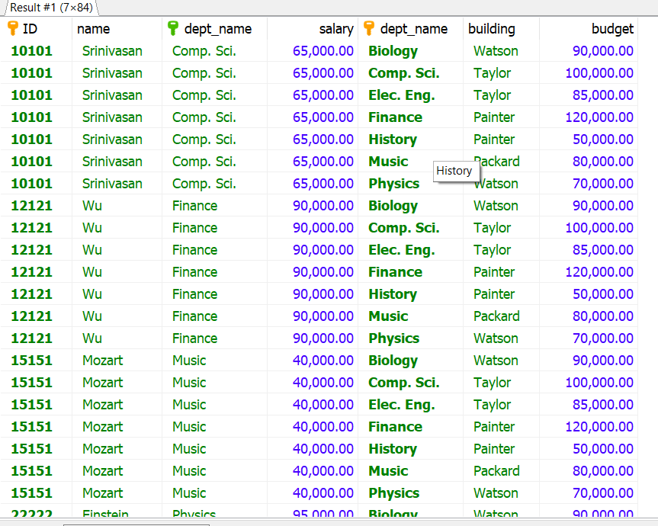
Cartesian Product
instructor X department

Slide 17
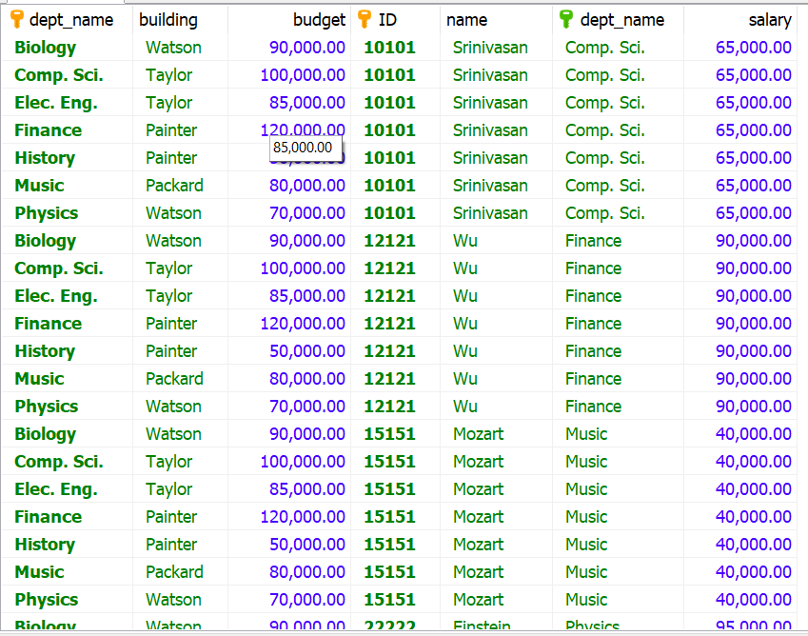
Cartesian Product
department X instructor

Slide 18
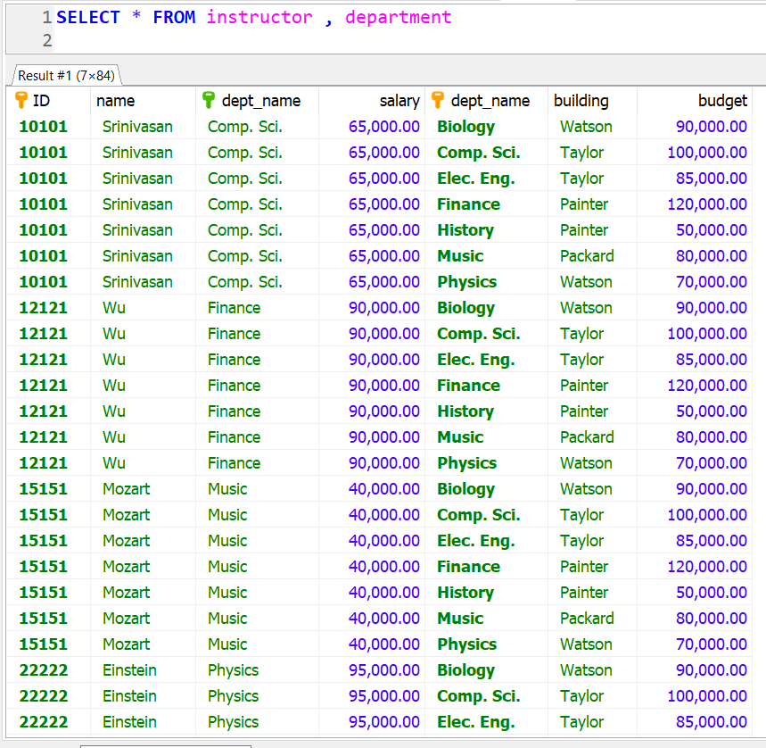
Cartesian Product in SQL
This result is not very heplfull.
We need to filter out the records that make sense based on some common fields between two relations

Slide 19
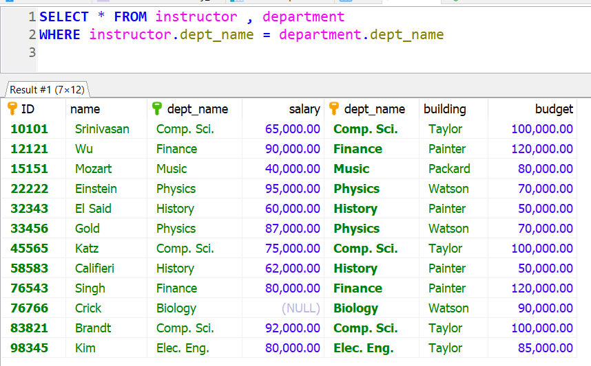
Cartesian Product in SQL

Slide 20
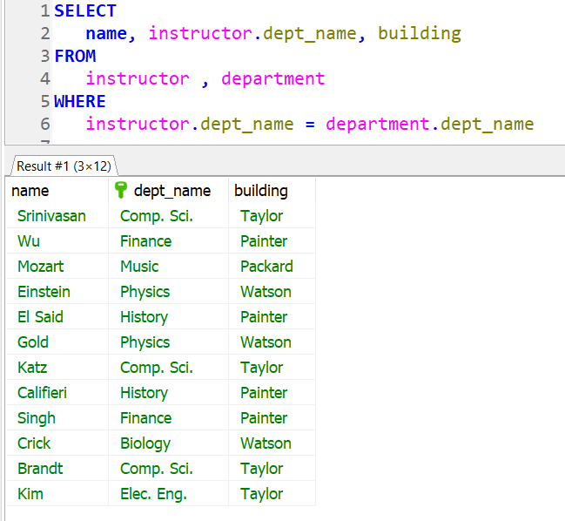
Show me a list containing all teachers name, their respective department and the building the department is situated.

Slide 21
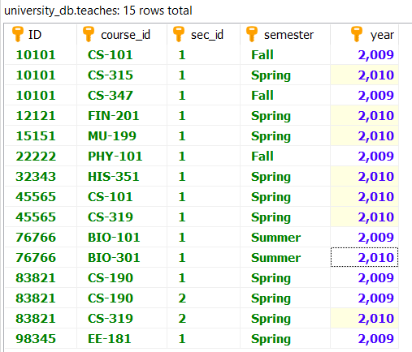
Find the names of all instructors who have taught some course and the course_id of those courses, and year

Slide 22
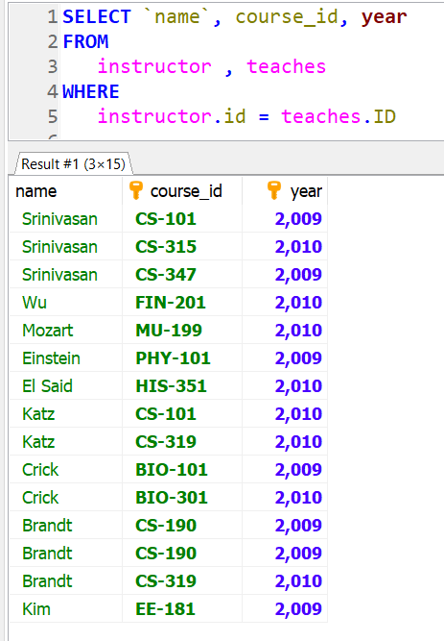
Find the names of all instructors who have taught some course and the course_id of those courses
What if I also need course name?

Slide 23
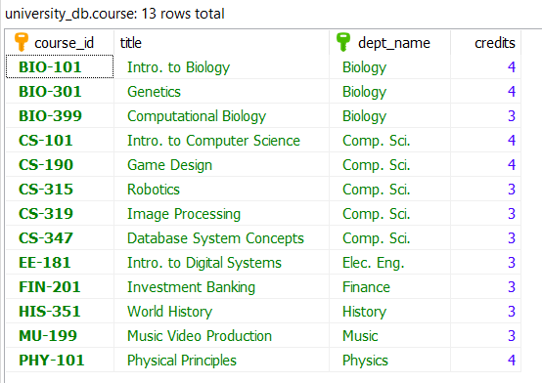
Find the names of all instructors who have taught some course and the course_id, course name of those courses, and year

Slide 24
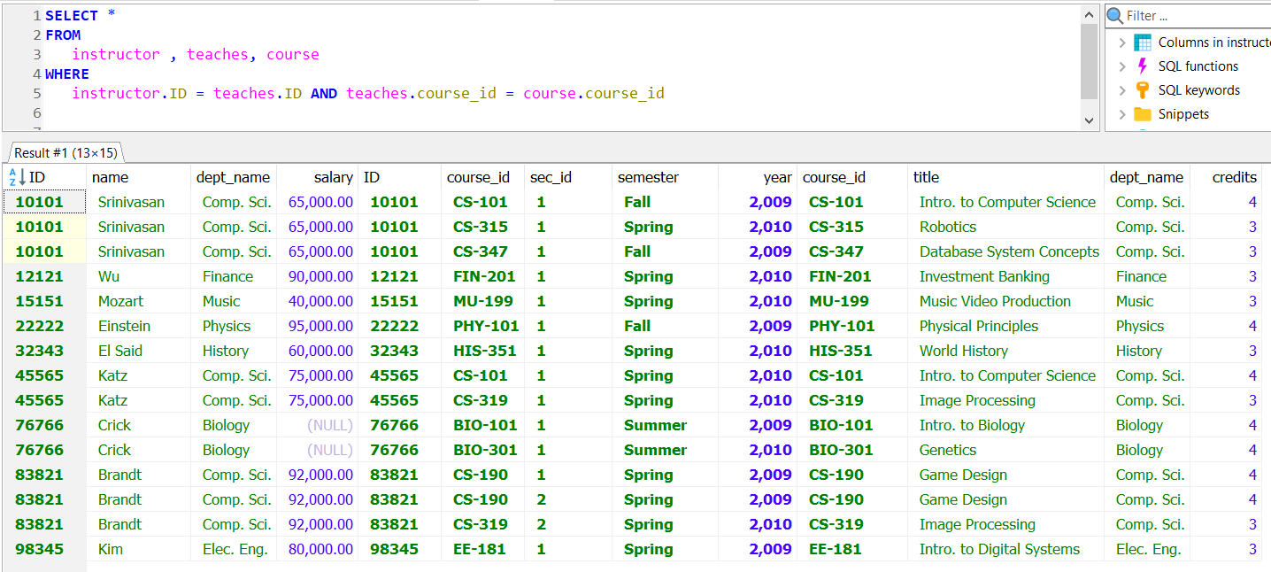

Slide 25
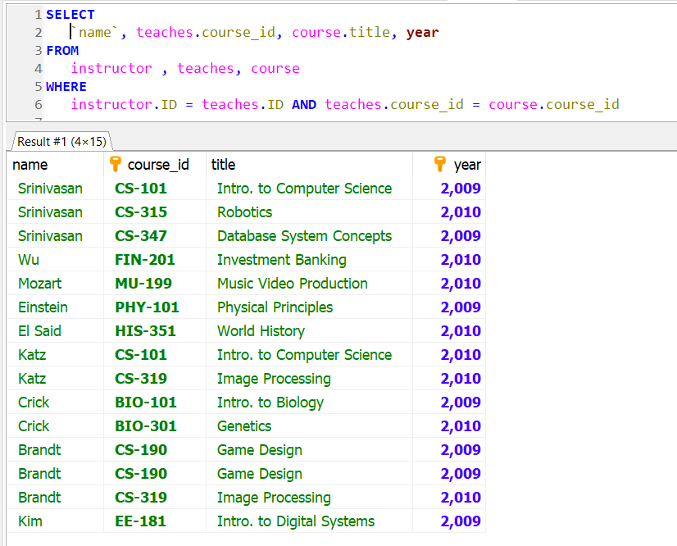
Find the names of all instructors who have taught some course and the course_id, course name of those courses, and year

Slide 26
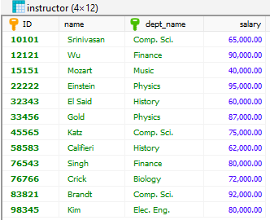
Combining a relation with itself
Find the names of all instructors who have a higher salary than some instructor in ‘Comp. Sci’.

Slide 27
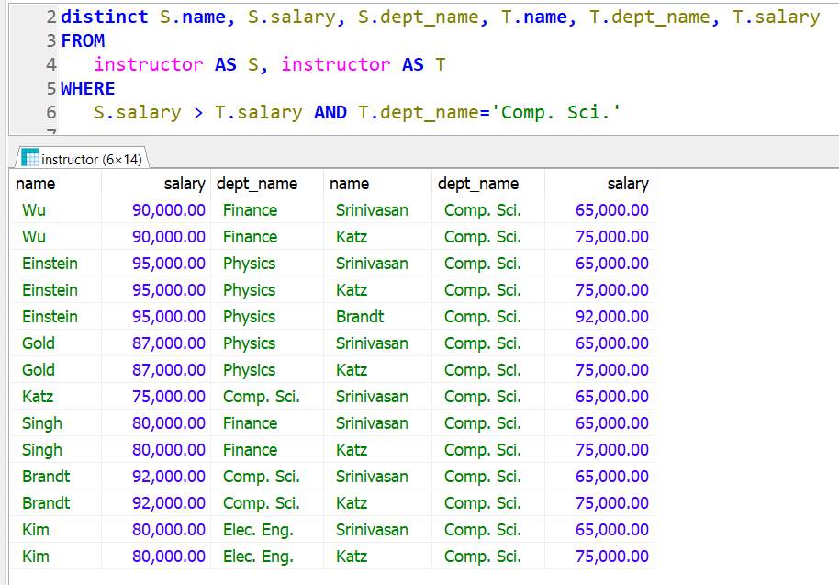
Find the names of all instructors who have a higher salary than some instructor in ‘Comp. Sci’.

Slide 28
The Rename Operation
The SQL allows renaming relations and attributes using the as clause:
old-name as new-name
Find the names of all instructors who have a higher salary than some instructor in ‘Comp. Sci’.
select
distinct S.name from
instructor as S, instructor as T where
S.salary > T.salary and T.dept_name = ‘Comp. Sci.’
Keyword as is optional and may be omitted instructor as T ≡ instructor T

Slide 29



The Natural Join
To make the life of an SQL programmer easier for this common case, SQL supports an operation called the natural join

Slide 30
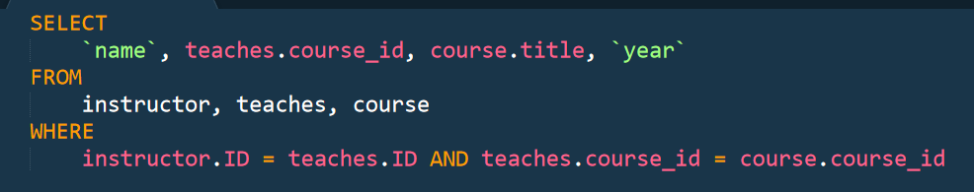
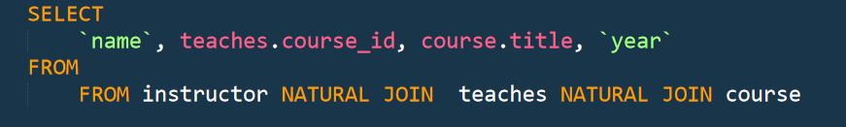
The Natural Join
To make the life of an SQL programmer easier for this common case, SQL supports an operation called the natural join

Slide 31
Demo.

Slide 32
End.

